Slide 1
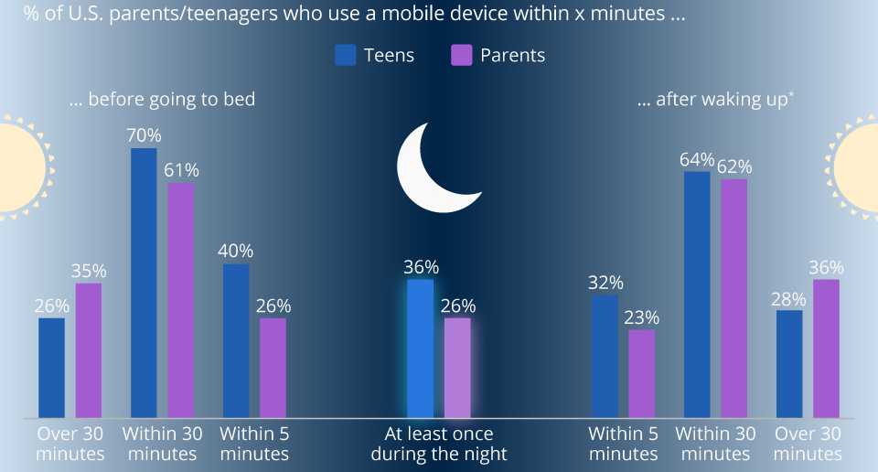



Well-Phone
Introduction
We aimed to improve long term quality of life through a consistent positive reward based system for children, by removing their phones before bed.
Benefits
Delayed Gratification
Develop Positive Behaviors
Builds Healthy Habits into Adulthood
Recognize Feelings
Improves Physical Health
Better Sleep Quality
Smartphone Lockbox
Specs:
Richter, F. (2019, May 31). Infographic: America's favorite bedside companion? Statista Infographics. Retrieved March 20, 2023, from https://www.statista.com/chart/12017/smartphone-use-in-the-morning-and-at-night/
Next Steps
Turning the Well-Phone into a usable tool for children by:
- Creating app that controls Well-Phone Lockbox.
- List activities/goals to set on app
- Make rewards list that displays current streak and points to claim reward.
Features
Alarm Clock
Wireless Charging
UV Cleaning
Sleep Environment Sensor
Built-In AI Assistant
Physical, Mental and Emotional Activity Prompts
Automatic Locking Mechanism
EmotionMirror App Integration
Curtis Ficor, Sharmarke Hassan, Jadon Donais
UR courses: Log in to the site. (n.d.). Retrieved March 21, 2023, from https://urcourses.uregina.ca/mod/page/view.php?id=1971431
Visual identity. University of Regina. (n.d.). Retrieved March 20, 2023, from https://www.uregina.ca/communications-marketing/visual-identity.html#fact_15_5

